Slide 1
Notes:
Make reference to the Tagline – Opportunity for all. It is at the root of everything we stand for/work toward. A belief that everyone regardless of the circumstances of their life, deserves opportunity/access to lead the life they deserve to lead.
We recognize that the people we support present with a unique set of challenges, often compounded by a chronic lack of opportunity, made worse by systemic societal injustices. Our service model is innovative, person-centered, and rooted in choice and self-direction, allowing us to treat the whole person, providing opportunities that would not exist without the supports we offer.
At S:US, we embrace diversity (reference hiring practices—staff reflective of those we support, hire from the communities where we have our residences and programs, non discriminatory in our hiring…)
We work to advance social justice and racial equity (reference our advocacy for staff through bfair to direct care; partnership with the unions who represent our frontline staff; leaderships involvements on govt. committees to influence policy to better serve the interests of people we support; ….)
Our workforce of 2,000 partners with people we support to create opportunities that generate permanent, positive change in their lives.

Slide 2
OVERVIEW OF S:US
Founded in 1978
Serving 37,000+ individuals and families each year
Employing close to 1,800 staff members
Providing $250+ million in services
Notes:
Founded in 1978
Serving 37,000+ individuals and families each year
Employing close to 2,000 staff members
Providing $250+ million in services
Federal, state and city contracts and grants
Foundation and corporation grants and sponsorships
Individual donations
S:US has a 40+ year history, starting with sheltering and feeding people – steady development over the years to the current size/scope
We’ve had requests from funders and other organizations to expand or develop new programs, and have grown through mergers and collaborations with other organizations.
We are known for:
cutting edge approaches and a reliance on evidence-based and promising practices
continuous quality improvement, and
- A culture of learning
Revenue sources
Each funder contractor or donor has expectations for the way we will use their money
We have high expectations for our own ethical conduct as a business and in our relationships with the community
Services
Housing services that promote independent living, and support and tools that empower people with behavioral health disorders, veterans and others to move beyond diagnosis and the complex life circumstances they face.
Person-centered services for children and adults with developmental disabilities to allow for full inclusion and participation in communities of their choice

Slide 3
OVERVIEW OF S:US
Mission
Vision
Uniqueness
We drive scalable solutions to transform the lives of people with disabilities, people in poverty and people facing homelessness: solutions that contribute to righting societal imbalances.
We envision a city where everyone has a roof over their head, is healthy, productive and can enjoy the social connections that create a life of purpose.
We take what we learn on the ground and use it to change systems and impact policy and create opportunities for all.

Slide 4
OVERVIEW OF S:US
Continuous Quality Improvement
S:US engages in an ongoing effort to improve its services and internal practices.
Respect
S:US acts on its belief in the essential dignity and value of each individual by treating everyone with compassion, care and courtesy.
Maximize Potential
S:US works with people to help them reach their individual potential.
Supportive Culture
S:US believes that people need each other to achieve their goals, and creates a supportive environment where people can share ideas and information freely, to foster creativity, communication and collaboration.
Integrity
S:US is committed to acting with integrity, as demonstrated by treating people consistently, honestly and fairly to help them achieve their own goals and the goals of the agency.

Slide 5
OVERVIEW OF S:US
WHO WE SERVE
IMPACT
People with mental illness and addiction challenges
People living with HIV/AIDS
Veterans who are challenged by homelessness, depression, PTSD, and unemployment
People with autism and other intellectual/ developmental disabilities
Men, women and children who have experienced domestic violence
People who have lost their homes
People living in poverty
On any given night, S:US provided housing and shelter to more than 4,500 individuals.
95% of S:US' permanent housing residents maintained stable housing.
We distributed almost $2M in cash assistance to help people stay in their homes.
We engaged in 1,700 prevention interventions, including providing anti-eviction resources, and helped 170 individuals and families avoid entering the shelter system.
500 individuals moved from our shelters, residential treatment, and transitional housing into permanent homes of their own.
We engaged more than 600 people in therapeutic horticulture, nutrition programming, and vocational training at our 50+ Urban Farms and Gardens, which yielded approximately 8,700 pounds of food from fruit, vegetables, and culinary herbs.

Slide 6
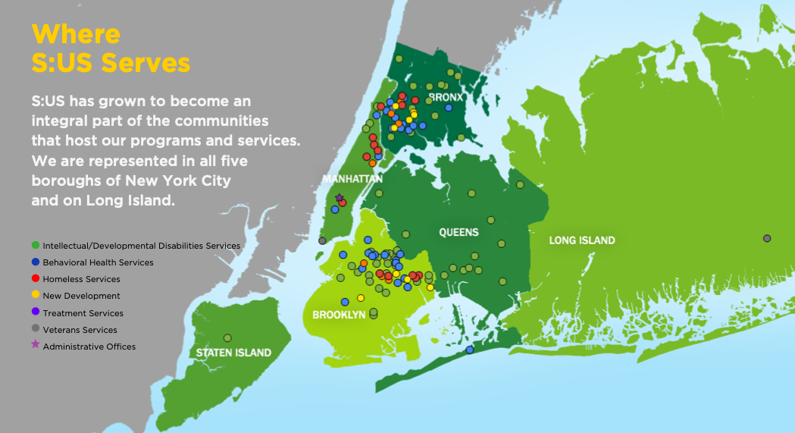

Slide 7
OVERVIEW OF S:US
PROGRAM PORTFOLIO
DEVELOPMENTAL DISABILITIES SERVICES
HOMELESS SERVICES
HOUSING
BEHAVIORAL HEALTH SERVICES
VETERANS SERVICES
URBAN FARMS

Slide 8
BEHAVIORAL HEALTH SERVICES
Outpatient Behavioral Health Clinics
Residential Treatment Programs
Care Coordination
Community Treatment Programs
Home and Community Based Services (HCBS)
Residential Substance Use Disorder Treatment
HIV Support Services
Recovery Services
Peer Services
Clubhouse & Transitional Employment Program
Supported Employment
Crisis Respite Center
Services to People with Criminal Justice Histories: Forensic Re-Entry
Services to People with Criminal Justice Histories: Forensic Enhancement Services

Slide 9
HOMELESS SERVICES
PROGRAM TYPE | NUMBER OF LOCATIONS
Emergency/Transitional Housing – Homeless Shelters | 7
Domestic Violence | 2
HASA | 2
Prevention – Homebase | 1
S:US has served individuals and families who are homeless, at risk of becoming homeless and formerly homeless.
The array of homeless-related services we provide includes seven NYC Department of Homeless Services shelters; two Human Resources Administration HIV/AIDS Services Administration transitional residences; and two NYC Department of Homeless Services Domestic Violence residences.
Our shelters serve individuals and families throughout NYC and are located in the Bronx (4), Manhattan (3), and Brooklyn (4).

Slide 10
EMERGENCY/TRANSITIONAL HOUSING
126th St Shelter (2010) 90 beds in Harlem
Anchor Family Shelter (2019) 29 units for families in Bronx
Blake Avenue (2012) 151 beds in Brooklyn
Echo (2019) 29 units for families in Bronx
Harmonia ( (2018) 170 units in Manhattan
Renaissance (2015) 200 beds in Brooklyn.
Rose McCarthy (Dumont) - Annex Site: Rose McCarthy (Van Siclen) (2014) has 53 units for families
The Fane (2010) 61 beds in Harlem
Notes:
S:US’ Homeless Services Division includes: ( total of 8 sites)
Two Mental Health Single Adults shelters:
Blake Avenue, in operation since 2012, has 151 beds in Brooklyn;
Renaissance, in operation by S:US since August, 2015, has 200 beds in Brooklyn.
Two Single Adults shelters (described above):
The Fane, in operation since 2010, has 61 beds in Harlem
126th Street, in operation since 2010, has 90 beds in Harlem.
Three Family shelters:
Rose McCarthy, in operation by S:US since 2014, has 53 units for families (153 individuals) in Brooklyn;
Anchor, opened by S:US in fall 2019, has 29 units for families in Bronx. In fall of 2020 expanded the shelter
Echo, to operate an additional 63 units for families.
One Adult Family shelter,
Harmonia, in operation since 2018, has 170 units serving 340 adults in Manhattan.

Slide 11
EMERGENCY/TRANSITIONAL HOUSING
Emergency Transitional Housing Programs for People Living with HIV/AIDS (HASA)
St. John’s, in operation since 2005, has 68 beds in Brooklyn.
Domestic Violence Shelters
Aegis, in operation since 1981, is an emergency crisis shelter for families that serves up to 60 individuals (20 adults and 40 children);
Athena, in operation since 2002, a Tier II transitional residence for families that serves 20 families (approximately 50 individuals).

Slide 12
91st Street Welcome Center
Programming and Services: Welcome centers are low-barrier programs specifically targeted toward unsheltered individuals. The Welcome Centers are equipped with on-site services and staff who work closely with unsheltered New Yorkers to build trust, stabilize lives and encourage further transition off the streets.
The Welcome Centers operate as immediate need/pre assessment sites. The goal is to quickly bring New Yorkers experiencing unsheltered homelessness inside and connect them to compassionate staff who, first work to meet their immediate needs, cultivate a relationship and then discuss their long term needs and the services and transitional housing options available to them. By forming a rapport with the clients over time , Welcome Center staff are better able to assess the longer-term needs of the clients and more effectively communicate the options available to them.
Because Welcome Centers are focused on connecting clients to other ,longer term DSS-DHS facilities , the average lengths of stay at the Welcome Centers are shorter that at other DSS-DHS facilities. The stay is usually 30 days or less depending on the assessment .
Notes:
S:US’ Homeless Services Division includes: ( total of 8 sites)
Two Mental Health Single Adults shelters:
Blake Avenue, in operation since 2012, has 151 beds in Brooklyn;
Renaissance, in operation by S:US since August, 2015, has 200 beds in Brooklyn.
Two Single Adults shelters (described above):
The Fane, in operation since 2010, has 61 beds in Harlem
126th Street, in operation since 2010, has 90 beds in Harlem.
Three Family shelters:
Rose McCarthy, in operation by S:US since 2014, has 53 units for families (153 individuals) in Brooklyn;
Anchor, opened by S:US in fall 2019, has 29 units for families in Bronx. In fall of 2020 expanded the shelter
Echo, to operate an additional 63 units for families.
One Adult Family shelter,
Harmonia, in operation since 2018, has 170 units serving 340 adults in Manhattan.

Slide 13
91st Street Welcome Center
A secure and safe environment is critical to the success of any program facility. DSS-DHS and S:US are committed to prioritizing the safety of the clients, staff and community members.
The Welcome Center is staffed with:
24 –hour residential specialists, shift supervisors and contracted security guards to provide a strong security presence at all times.
There is 24- hour camera surveillance around the building to monitor activities and ensure a safe environment.
Conducting hourly rounds by staff include the surrounding building area as a proactive approach to security . By ensuring there is no loitering in front of the building a secure and welcoming atmosphere is maintained for everyone.
This Photo by Unknown author is licensed under CC BY-SA-NC.
Notes:
S:US’ Homeless Services Division includes: ( total of 8 sites)
Two Mental Health Single Adults shelters:
Blake Avenue, in operation since 2012, has 151 beds in Brooklyn;
Renaissance, in operation by S:US since August, 2015, has 200 beds in Brooklyn.
Two Single Adults shelters (described above):
The Fane, in operation since 2010, has 61 beds in Harlem
126th Street, in operation since 2010, has 90 beds in Harlem.
Three Family shelters:
Rose McCarthy, in operation by S:US since 2014, has 53 units for families (153 individuals) in Brooklyn;
Anchor, opened by S:US in fall 2019, has 29 units for families in Bronx. In fall of 2020 expanded the shelter
Echo, to operate an additional 63 units for families.
One Adult Family shelter,
Harmonia, in operation since 2018, has 170 units serving 340 adults in Manhattan.

