Slide 1
Building a stronger community for Roosevelt Island

Slide 2
Overview
Our organization is dedicated to improving the lives of residents on Roosevelt Island by enabling collaboration between citizens, businesses, and city authorities to create solutions to urban challenges to improve economic and environmental outcomes.

Slide 3
Functional Overview
Residents
Organizations
Get acclimated to community
Create and improve services
View services and resources, get resident alerts.
Publish content to repository of services offered by organizations
Get help to challenges
Residents Registration
Consolidated resources at city and state level
Enable residents to register for services
Provide feedback
Understand resident challenges
Provide feedback on existing services as well new needs.
Get feedback on existing services as well need for new ones.
The Platform

Slide 4
Roadmap
Residents get practical data to help get acclimated
Residents can provide feedback on challenges
Organizations can participate in solving challenges
Residents and Organizations contribute to a healthy community
Phase 1
Phase 2
Phase 3
Phase 4
Q2 2024
Q3 2024
Q4 2024
Q1 2025
Transit
Map Visualization
Org Dashboard
Initiatives
Services
Red Bus
Profiles
eCommerce
Island Overview
Survey
Registration
AI Modeling
Alerts
Get Help
Marketing
City Sensors

Slide 5
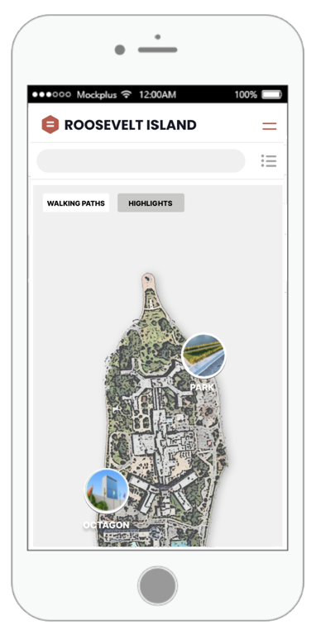
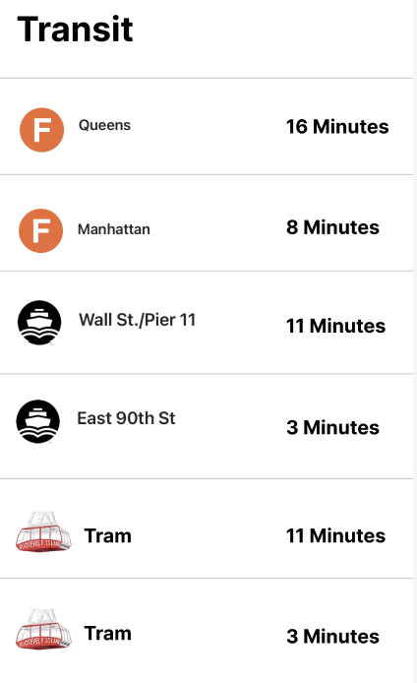
App Design - Transit

