Slide 1
Fitness Equipment Proposal
to Community Board 8
December 3, 2020
Presented by Stacy Papas
Executive Director
Friends of the East River Esplanade (60th-120th Streets), Inc.
Notes:
Thank you
Tonight I will be presenting the addition of outdoor, all-weather fitness equipment to the esplanade
and I am speaking on behalf of our Fitness Committee: Susan Blackwell, Frederica Miller and Craig Starr.
TURN PAGE AND CLICK DOWN ARROW

Slide 2
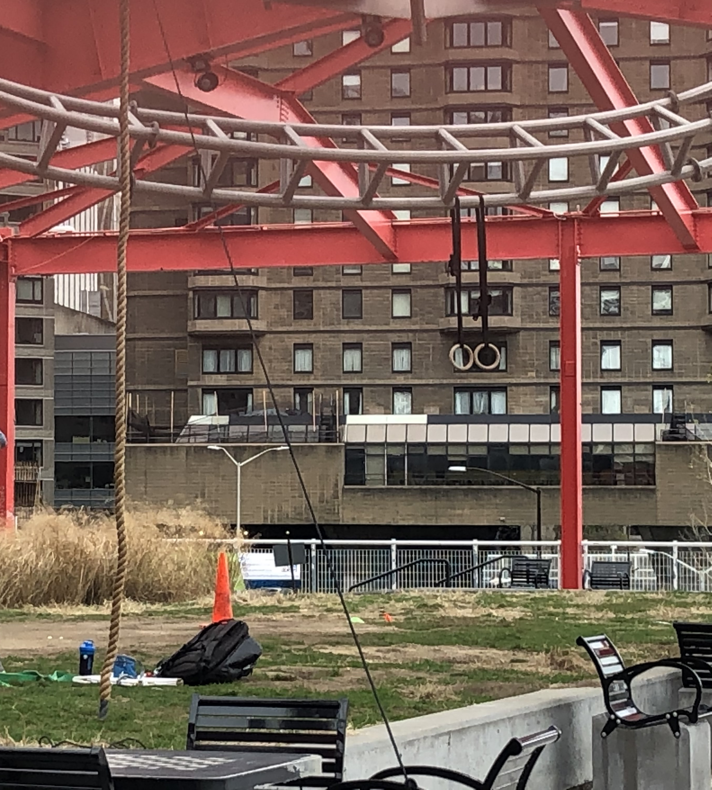
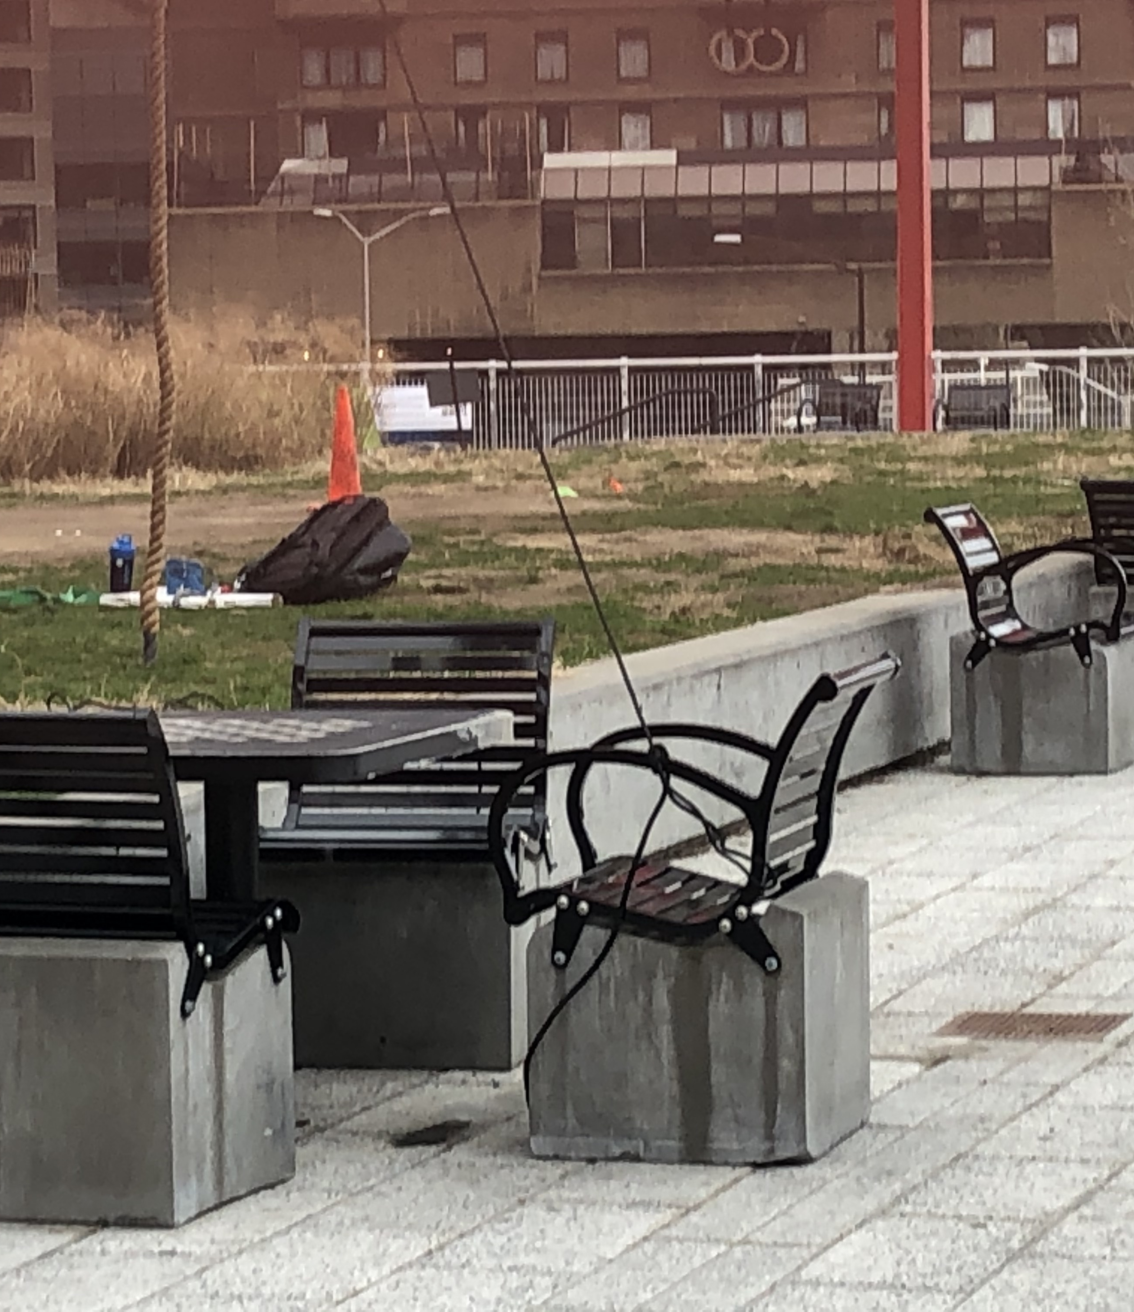
Today’s Outdoor Fitness Equipment
Notes:
Since gyms have closed, people have taken their workouts outside and have taken over playgrounds and parks.
This is the East River Roundabout.
[arrow down for flash] You can see the climbing rope
[arrow down for flash] the gymnastics rings
[arrow down for flash] and supporting rope
This is dangerous - without my arrows, you barely see these things hanging and the sculpture is not made to withstand the added weight of humans or the wear and tear of the climbing ropes.
However we can see that there is a need for fitness equipment.
So our fitness committee went out and spoke with the public.
TURN PAGE AND CLICK DOWN ARROW

Slide 3
Outreach in Support of Outdoor Fitness Equipment
456 signatures of support
79 in person signatures (including Nancy Prince, Chief of Landscape Architecture at NYC Parks)
377 on change.org petition
Social media posts
64 likes/loves on Facebook
16 likes on Instagram
NYCReopens.com
Jayna Alexandra, Columbia University Graduate School of Journalism
Notes:
We’ve got strong support from the community both in person and online.
Close to 500 signatures on our petition
80 likes on social media posts
Jayna Alexandra is a grad student at CU school of journalism and approached us after seeing our petition. She is writing an article about outdoor fitness in the pandemic. Currently she is interviewing people about this concept and with her professor’s approval, will publish her article on NYCReopens.com, Columbia’s newest publication dedicated to life in and after the pandemic.
We don’t see outdoor fitness as a short-term trend until gyms fully reopen. We see this is a long term activity for 3 reasons:
1. Geography - some people belong to gyms near their office and workout before during or after the work day. Since they are working from home, they may cancel that membership because they are no longer spend time in that neighborhood
2. Financial - People may no longer have disposable income for a gym membership
3. They like working out in the fresh air - This may be a new concept to some people and they may never go back to indoor exercise
The Fitness Committee then researched where this equipment could be placed on the esplanade.
TURN PAGE AND CLICK DOWN ARROW

Slide 4
Andrew Haswell Green Park Phase IIB
Notes:
We are looking at an architect’s rendering of Andrew Haswell Green Park upon completion of phase 2.
[FLASH ARROW]
This location has the width to allow pedestrians and bicyclists to pass without interference while also allowing for landscaping. It is also structurally sound enough to carry the additional weight of the equipment.
If people are concerned that they could be losing quiet space, rest assured Sutton Place has 5 parks for passive enjoyment.
The committee then put out an RFP to see what vendors would be interested in designing and installing the equipment. They narrowed it down to 4 different vendors with 4 unique concepts.
TURN PAGE AND CLICK DOWN ARROW

Slide 5
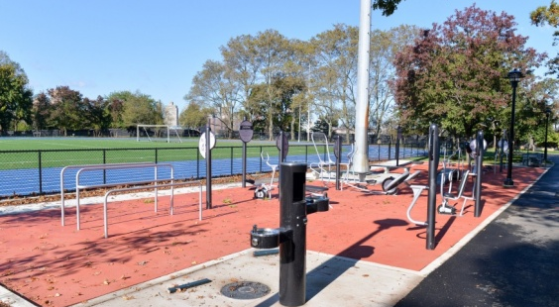
Landscape Structures
Notes:
Landscape Structures is employee owned and they do extensive work in NYC. This is Astoria Park and the equipment and set up is pretty straightforward and easily recognized as gym equipment.
TURN PAGE AND CLICK DOWN ARROW

Slide 6
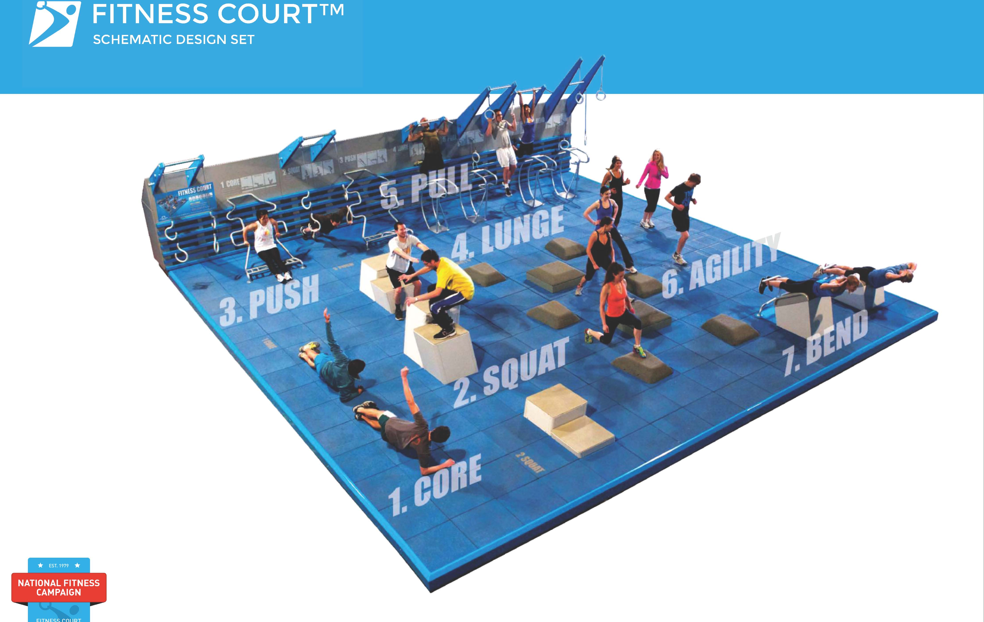
National Fitness Campaign
Notes:
The next vendor is National Fitness Campaign and they create a one size fits all concrete slab with a bodyweight circuit-training system for adults of all ages and fitness levels.
TURN PAGE AND CLICK DOWN ARROW
[Square - 38’ x 38’ concrete slab]

Slide 7
MY EQUILIBRIA
Notes:
Italian designer that has recently been added to the approved vendor list for NYC. They currently have installations in Miami, DC, and across Europe. Their work looks more like public art at first glance but upon closer inspection you can see that it is circuit training equipment.Their equipment & layout can be customized to fit any space.
TURN PAGE AND CLICK DOWN ARROW

Slide 8
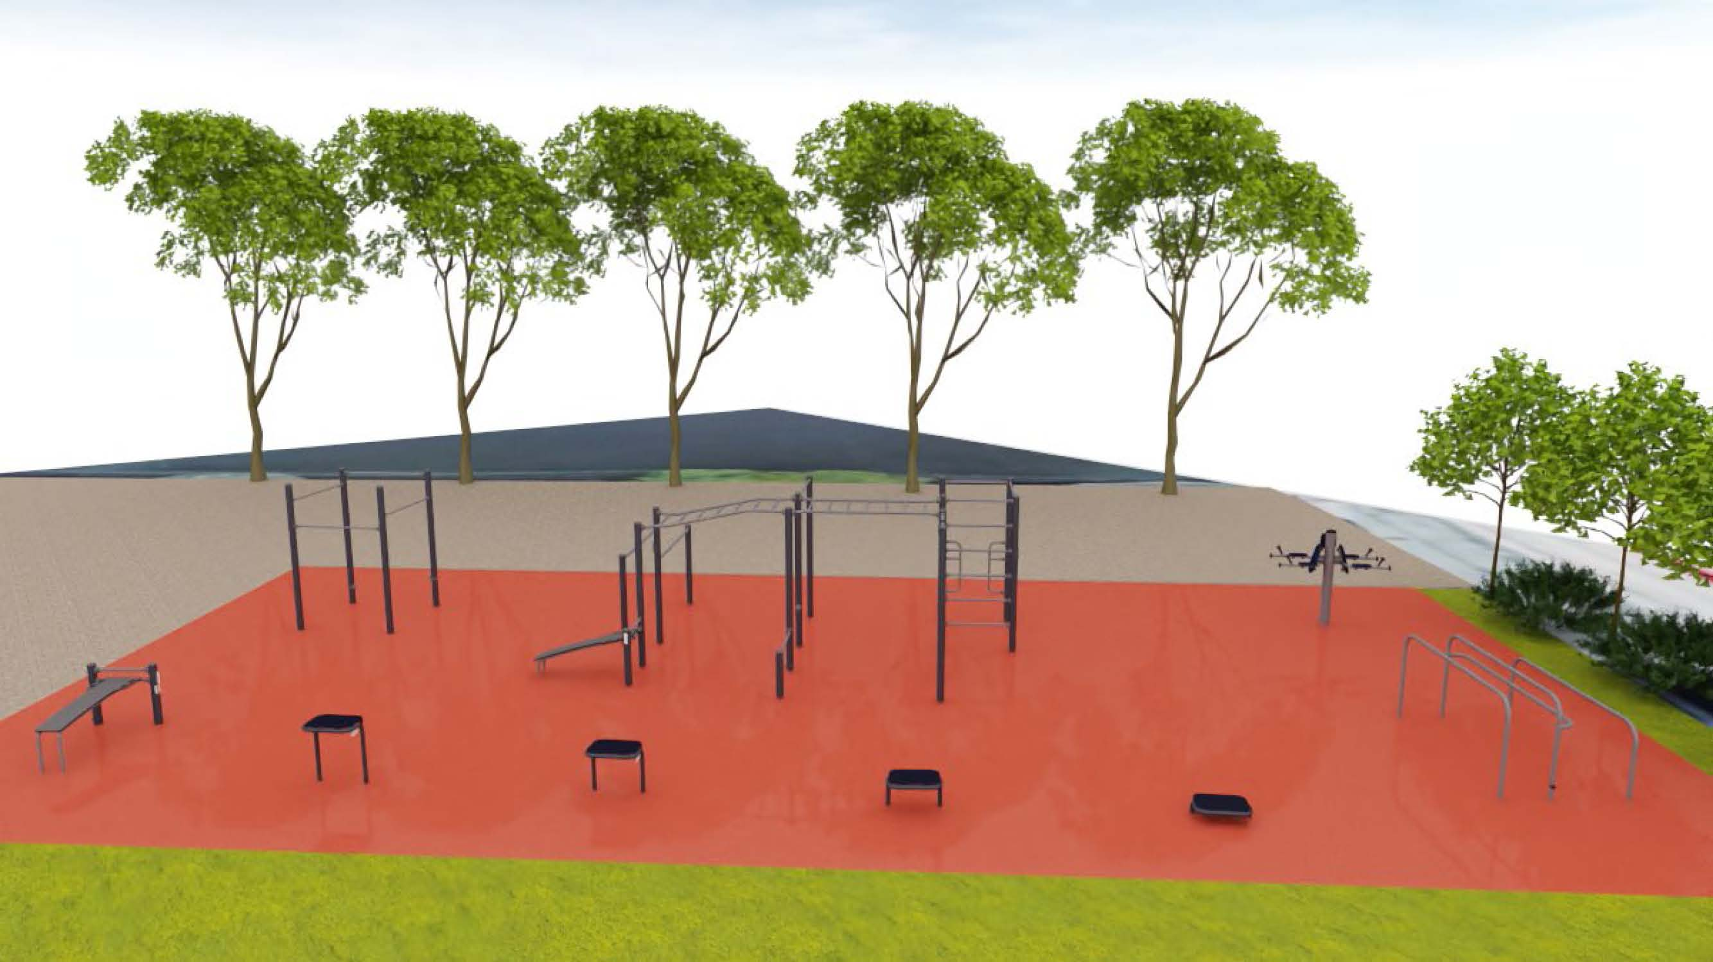
Kompan
Notes:
Lastly, we present Kompan. They are a Dutch firm. They have an extensive US presence, experience in NYC, and one equipment concept but their layout is completely customizable.
TURN PAGE AND CLICK DOWN ARROW

Slide 9
Conclusion and Q&A
Building a fitness-minded community
Short and long term benefits
Strong community support
Array of affordable design concepts that can easily be integrated into the site
Timing is right as Phase 2 has not started
Thank you for your time this evening.
Notes:
Adding fitness equipment to the esplanade will help bring together a fitness minded community. We already see people walking, running and biking. Now they can add circuit training for a full and well rounded outdoor fitness program.
Short term benefits - getting adults out of the playgrounds and public art space
Long term benefits - adding a much desired amenity on the esplanade for all to enjoy, providing safe equipment, and a dedicated space for the fitness community.
The cost of each concept is roughly the same, in the $100,000 -$120,000 range and EsplanadeFriends would lead the fundraising efforts for this.
and lastly
Since Phase 2 construction has not started, this concept could easily be added into the current design with little modification.
I am happy to take questions and if I am not able to answer them fully, Susan, Craig or Frederica can weigh in tonight or I will get answers from them and get back to you.

